Slide 1
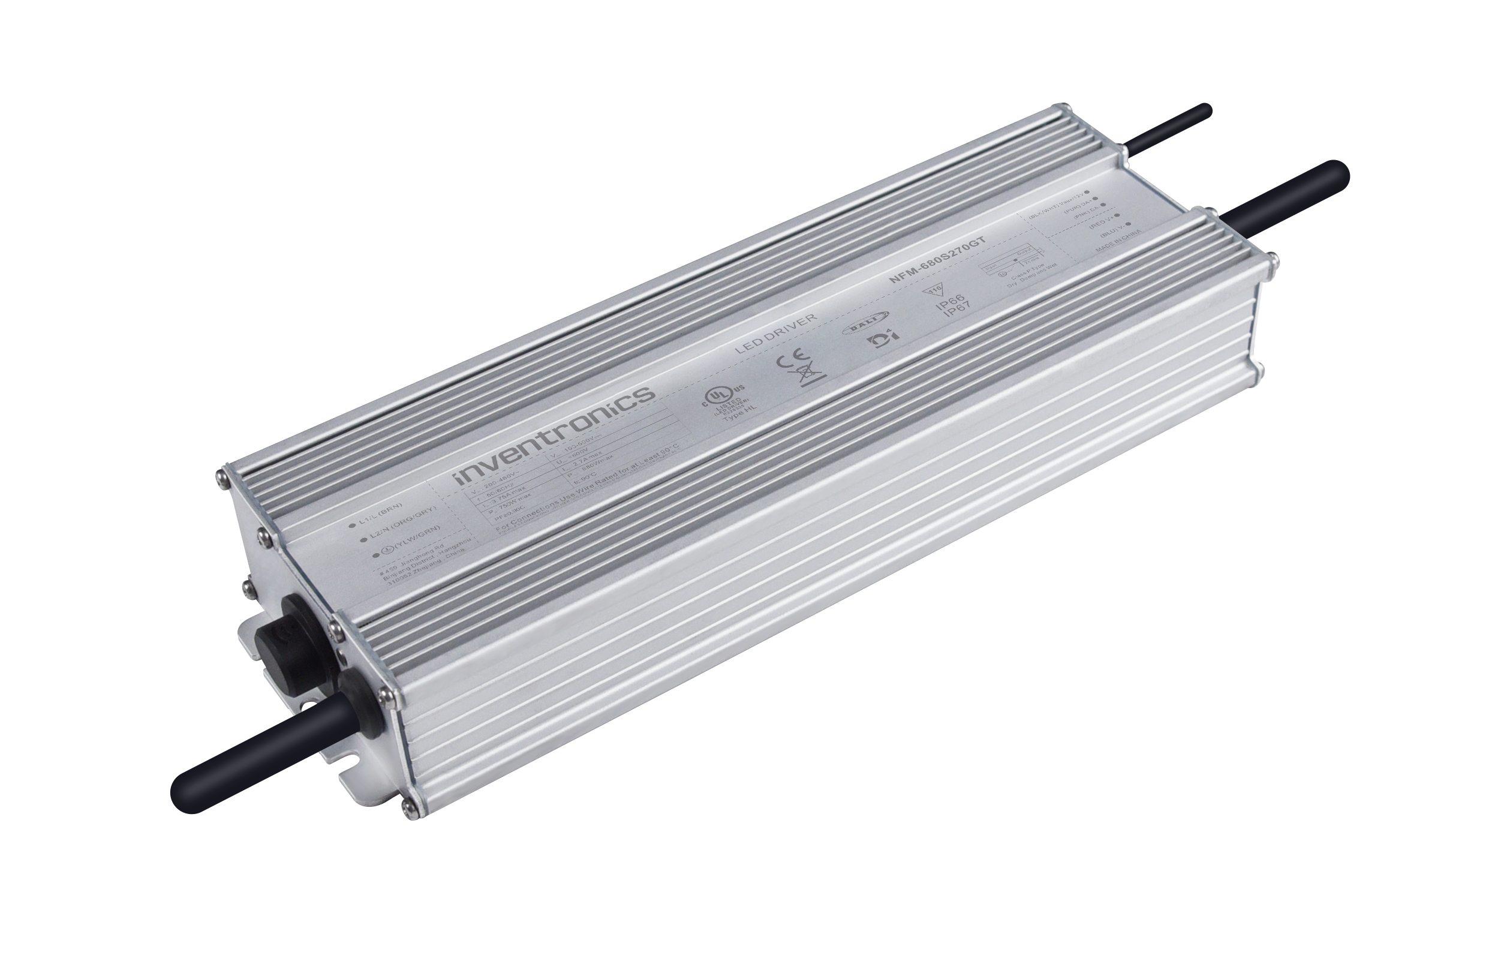
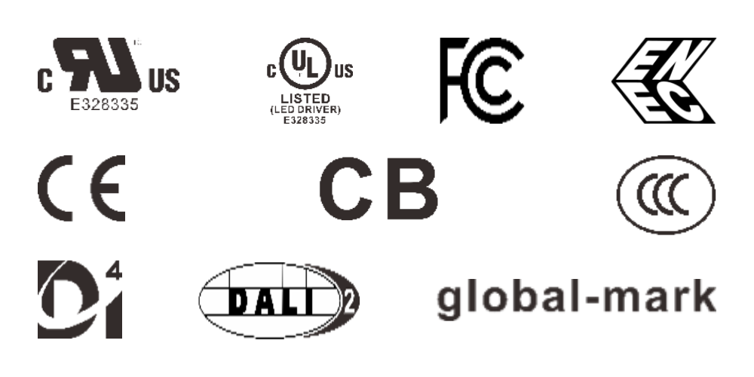
NFM
180~528Vac
Non-Isolated LED driver for sports lighting
Key Features
Ultra High Efficiency (Up to 98%)
Non-Isolated Class I Driver (Single Channel)
No Afterglow
Minimum Dimming Low to 0.1%-DALI/DMX Mode
Dim-to-Off with Standby Power ≤ 0.5W @ 230Vac
Adjustable Output Current (AOC) with NFC
Integrated Power Metering
Controls Up to 44 fps Integrated Power Metering with High Accuracy Up to ±1%
12V Auxiliary Power-Except DMX Mode
Input Surge Protection::DM 10kV, CM 10kV
Dimming Functions
DALI-2 & DMX-RDM Dimmable & Adjustable 0-10V & PWM & 3-Timer-Modes Dimmable & Resistor (Gx Model)
Adjustable 0-10V & PWM & 3-Timer-Modes Dimmable & Resistor (Mx Model)

Slide 2
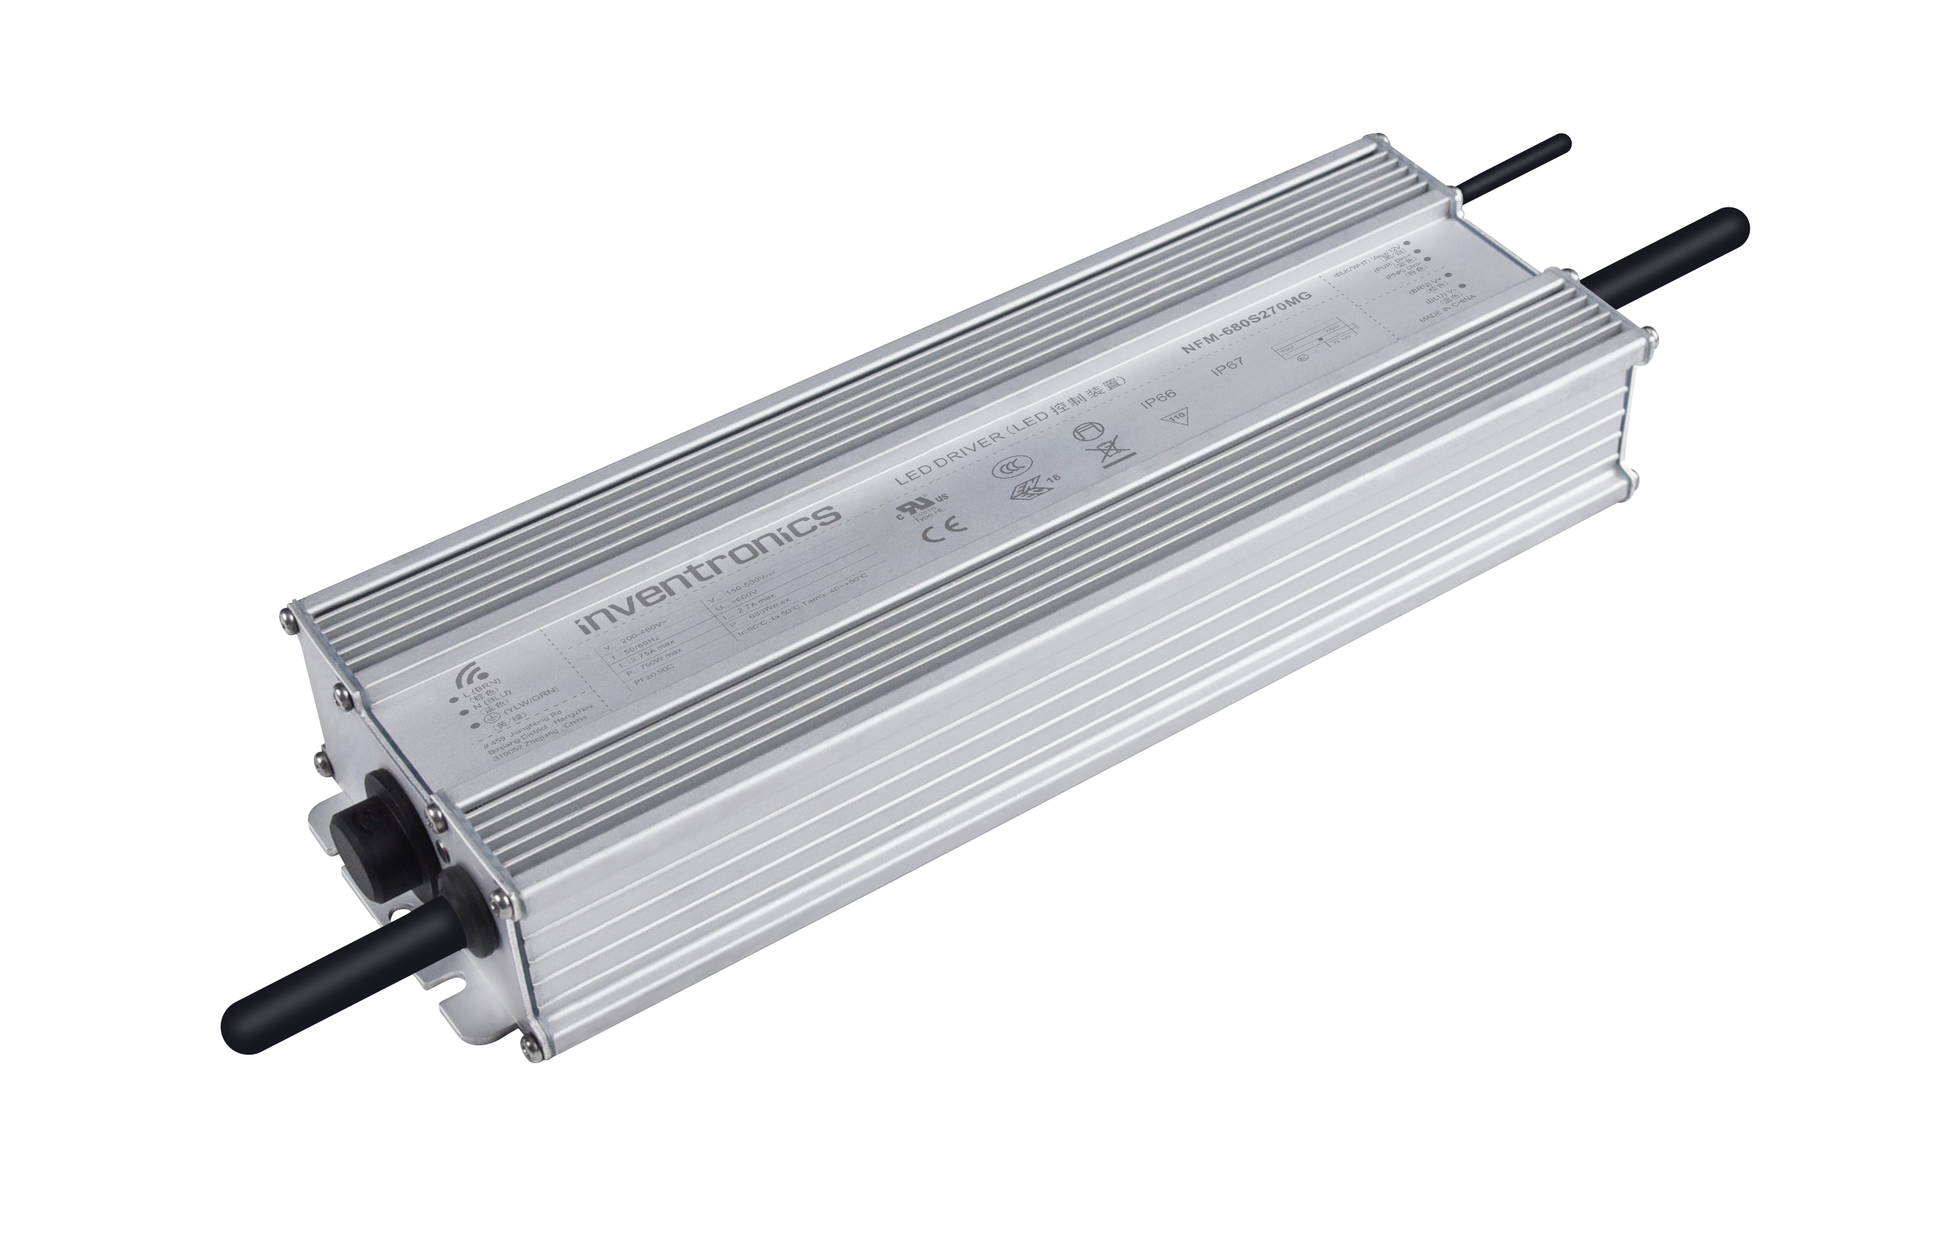
NFM
180~528Vac
Non-Isolated LED driver for sports lighting
Target Applications
Sports Lighting
Horticulture Lighting
High Mast Lighting
Output Power (W) | Model No. | Full-Power Current Range (mA) | Output Voltage Range (Vdc) | Eff. @400Vac | Lifetime (hours) | Dimensions (LxWxH)(mm)
680 | NFM-680S270Gx/Mx | 1360 ~2700 | 150 ~ 500 | 97.0% | 100,000 Tc=70ºC | 275(256) x 90 x 43.5
1200 | NFM-1K2S480Gx/Mx | 2400 ~ 4800 | 150~ 500 | 98.0% | 100,000 Tc=70ºC | 310(288) x 108 x 48.5

